Slide 1
Fuel Thermal Conductivity
NE 591

Slide 2
Housekeeping
You all should have received graded exams in your email
Exam 2 key is posted on moodle site
Any questions, please let me know via email or during office hours tomorrow
3rd and final exam tentatively scheduled for April 23
Will be open book and timed via moodle
Go into moodle, there is a an example assignment called “Upload test”
Upload a document into this Upload test assignment so that we can all make sure we are capable of using the moodle system

Slide 3
Last time
Many materials models for fuel are empirical and correlated to burnup
Fuel pellets change shape due to
Thermal expansion
Densification
Swelling
Creep
Fracture also decreases the gap, as fractures pieces shift outward
At high burnup but mid to low temperature the fuel restructures to have a small grain size and large bubbles
The structure is called High Burnup Structures (HBS)
HBS may actually improve many fuel properties

Slide 4
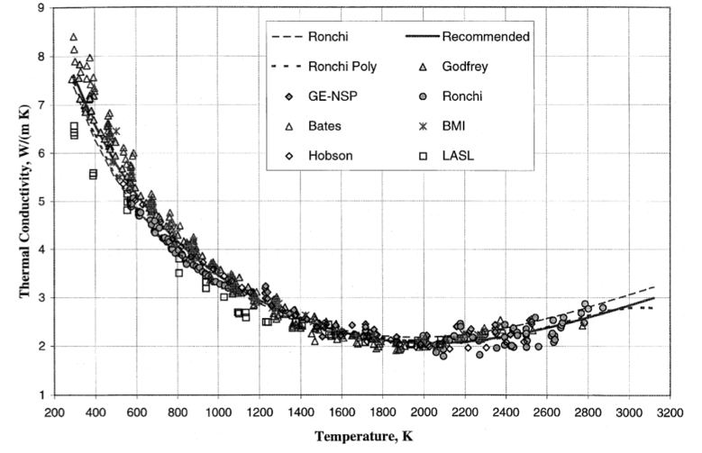
UO2 Thermal Conductivity
We have established correlations for thermal conductivity of fresh UO2 fuel as a function of temperature
Where t = T/1000
The first part of the equation describes the phonon interactions
The second part describes electronic transport which becomes significant at high temperature

Slide 5
UO2 Thermal Conductivity
UO₂ thermal conductivity is low and decreases more during reactor operation
The thermal conductivity has been collected after various amounts of burnup to make empirical fits

Slide 6
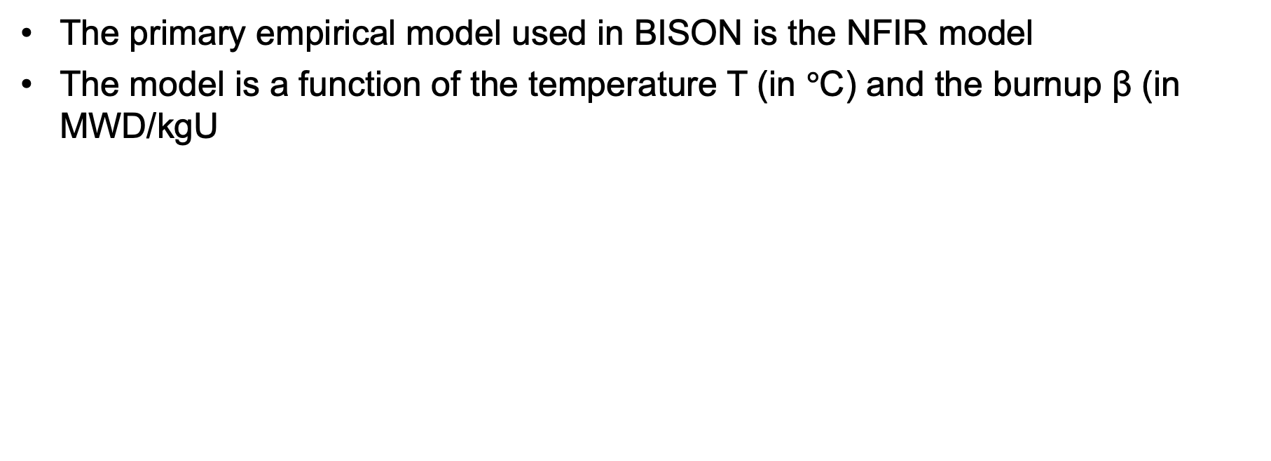
UO2 Thermal Conductivity
The primary empirical model used in BISON is the NFIR model
The model is a function of the temperature T (in $°$C) and the burnup β (in MWD/kgU

Slide 7
UO2 Thermal Conductivity
The R_{f} function switches between two k_{ph} functions

Slide 8
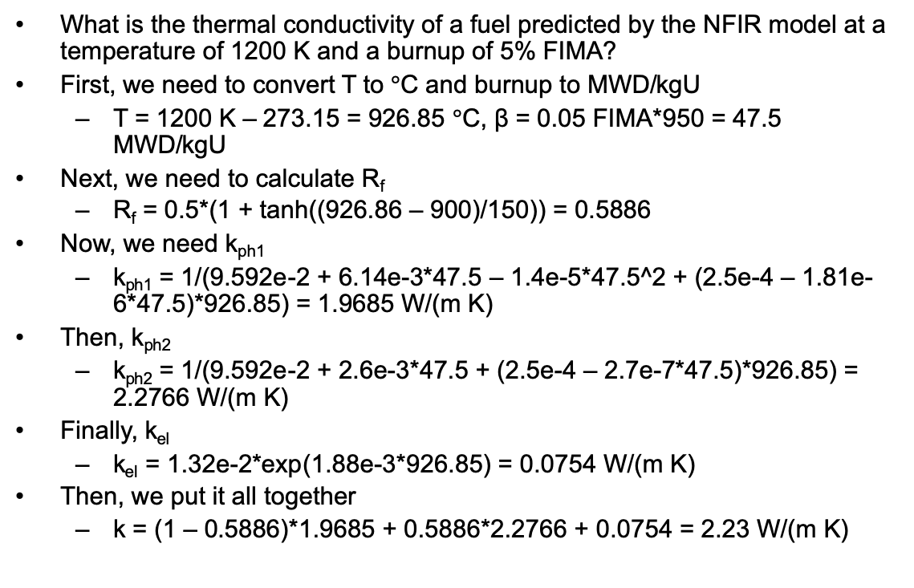
UO2 Thermal Conductivity Example
What is the thermal conductivity of a fuel predicted by the NFIR model at a temperature of 1200 K and a burnup of 5% FIMA?
First, we need to convert T to $°$C and burnup to MWD/kgU
T = 1200 K – 273.15 = 926.85 $°$C, β = 0.05 FIMA*950 = 47.5 MWD/kgU
Next, we need to calculate R_{f}
R_{f} = 0.5*(1 + tanh((926.86 – 900)/150)) = 0.5886
Now, we need k_{ph1}
k_{ph1} = 1/(9.592e-2 + 6.14e-3*47.5 – 1.4e-5*47.5^2 + (2.5e-4 – 1.81e-6*47.5)*926.85) = 1.9685 W/(m K)
Then, k_{ph2}
k_{ph2} = 1/(9.592e-2 + 2.6e-3*47.5 + (2.5e-4 – 2.7e-7*47.5)*926.85) = 2.2766 W/(m K)
Finally, k_{el}
k_{el} = 1.32e-2*exp(1.88e-3*926.85) = 0.0754 W/(m K)
Then, we put it all together
k = (1 – 0.5886)*1.9685 + 0.5886*2.2766 + 0.0754 = 2.23 W/(m K)

Slide 9
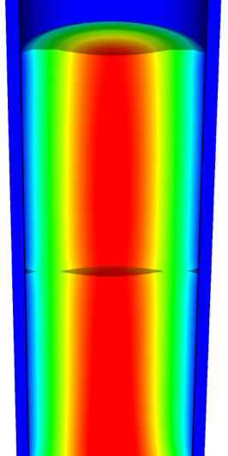
Going beyond burnup…
Operating Conditions
Neutron flux
Coolant T&P
Variables
Temperature
Displacement
Cladding
Property values
Fuel Property values
Fuel performance codes historically rely on materials models correlated to temperature and burn-up
Development has begun on models based on microstructure rather than burn-up
Elasticity tensor
Elasticity tensor
Burn-up
Yield stress
Thermal conductivity
Thermal conductivity
Fracture stress
Failure criteria
Melting temperature
Dimensional change
Diffusion constants
Gap conductance
Gap pressure
Dimensional change

Slide 10
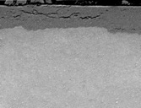
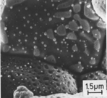
Microstructure-based fuel performance modeling
Structure/property relationships connect the microstructure variables to the property values
Operating Conditions
Neutron flux
Coolant T&P
Variables
Temperature
Displacement
Stoichiometry
Cladding
Property values
Microstructure evolution models
Microstructure evolution models
Fuel Property values
Elasticity tensor
Elasticity tensor
Grain growth
Grain growth
Cladding
Microstructure variables
Average grain size
Dislocation density
H concentration
Hydride fraction
Point defect concentrations
Loop density
2nd phase particle fraction
Fuel
Microstructure variables
Average grain size
Dislocation density
U defect concentrations
Pu concentration
Fission product precipitate fractions
Dissolved fission products
Fission gas bubble fraction
Grain boundary fission gas bubble coverage
Crack parameter
Plasticity
Plasticity
Thermal conductivity
Yield stress
Defect prod. & transport
Defect prod. & transport
Fracture stress
Thermal conductivity
Hydrogen transport
Fission gas behavior
Melting temperature
Failure criteria
Loop evolution
Densification
Diffusion constants
Dimensional change
Gap variable
Gap fission gas concentration
Fracture
Dimensional change

Slide 11

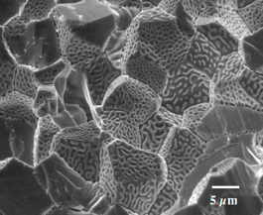
Example: fission gas behavior in the fuel
Take into account a finite set of variables to describe the state of the material
Utilize a mechanistic model of fission gas behavior to predict the evolution of the microstructure
Utilize this updated microstructure to inform a number of structure/property relationships
Variables
Temperature
Displacement
Stoichiometry
Elasticity tensor
Thermal conductivity
Model of fission gas behavior
Structure/property relationships
Fracture stress
Dissolved fission products
Fission gas bubble fraction
Grain boundary fission gas bubble coverage
Gap fission gas concentration
Dimensional change
Gap conductance
Gap pressure

Slide 12
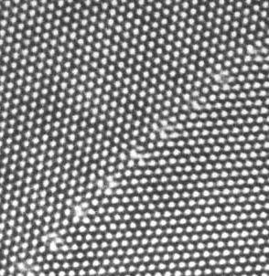
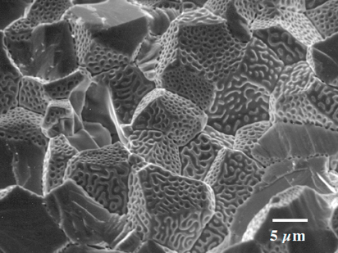
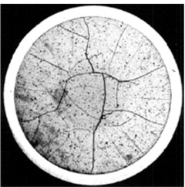
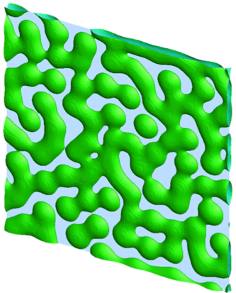
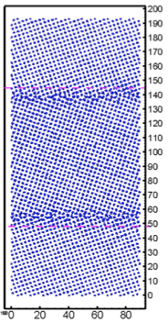
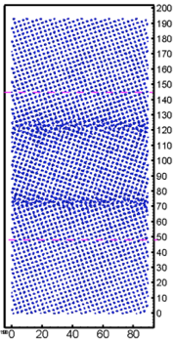
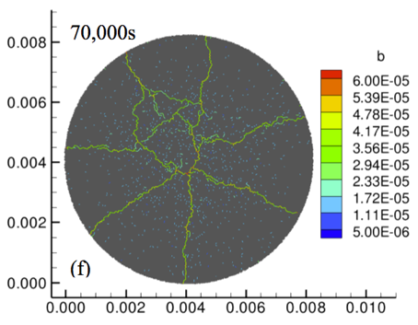
Multiscale separate effects experiments and simulations inform the development of the models
nm
μm
mm

Slide 13
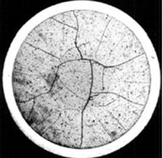
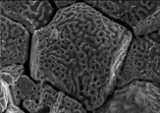
Microstructure-based models
Can provide a structure/property relationship to replace the existing burnup dependent model
For example, thermal conductivity, taking into account microstructural features and their evolution
Grain boundary and bubbles
Intragranular porosity
Precipitated fission products
κ_{pr}
Bulk conductivity
Vacancies and interstitials
Fission gas

Slide 14
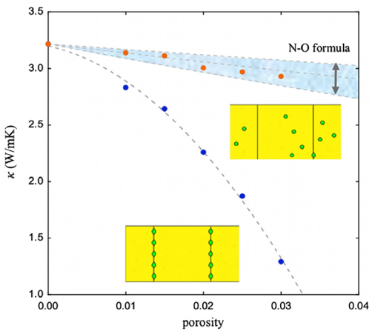
Parametrizing the mechanistic model
We employ multiscale modeling and simulation to determine the various parameters for the model
MD simulations conducted at LANL have been used to determine the coefficients for various point defects
MD simulations have shown that phonon scattering must be accounted for to accurately represent small bubbles
Mesoscale simulations have shown that GB bubbles have a larger impact on the thermal conductivity
Maxwell-Eucken (no phonon scattering)

Slide 15
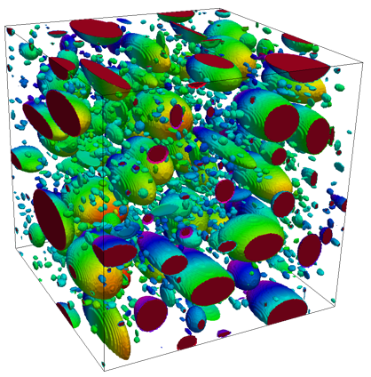
Parametrizing the mechanistic model
A thermal resistor model is created to describe the impact of GB bubbles on the thermal conductivity
MARMOT simulations are currently being used to inform the development of the precipitate multiplier

Slide 16
Parametrizing the mechanistic model
Each term in the expression must be coupled to a corresponding state variable
The full model calculates the thermal conductivity as a function of:
Temperature
Point defect concentrations
Intragranular bubble density and average radius
Fractional coverage of bubbles on GBs and average radius
Precipitate volume fractions and average sizes
Currently effects of precipitates fission products and individual point defects are neglected in the model, as they are not tracked or predicted in BISON

Slide 17
Comparing with experiments…
The model under-predicts the temperature in most cases, but not all
Thus, the model is neglecting some resistive effects from the microstructure
But generally performs as well, and in some cases better, than the burnup based model
RISO-3 AN3
RISO-3 AN4
RISO II-3
US PWR TSQ0002

Slide 18
Summary
The fuel thermal conductivity decreases with burnup
The NFIR model is a fairly accurate empirical model of the fuel thermal conductivity
Researchers are working to develop materials models for the fuel and cladding that are mechanistic rather than empirical and that are based on the evolution of the microstructure rather than the burnup.

Slide 19
MOOSE Project
We will be utilizing MOOSE for a project and we need to find a way to get it working for all
Go to this site: https://www.mooseframework.org/getting_started/ and try to download and install MOOSE on your own/local machine
Also, I am working on getting a functional MOOSE build on rdfmg cluster such that we don’t require individual students to have sufficient computing capacity
Once we all have MOOSE, we will do 1-2 lectures of training and examples

Slide 20
Presentation Project
Vedant: https://doi.org/10.1016/j.jnucmat.2019.151965
Yuqing: https://doi.org/10.1016/j.jnucmat.2020.152069
Khadija: https://doi.org/10.1016/j.jnucmat.2020.152050
Presentations will be conducted on ZOOM, Thursday, April 9
Article overview, background, motivation, brief methods, results summary, critical analysis, potential future work

Slide 21
Zirconium Cladding

Slide 22
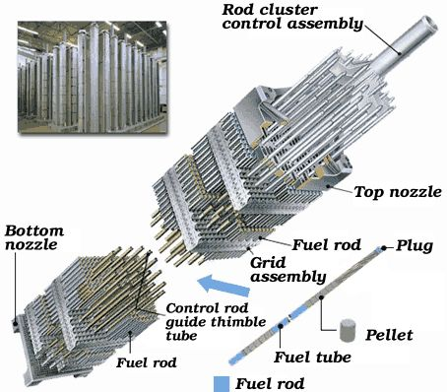
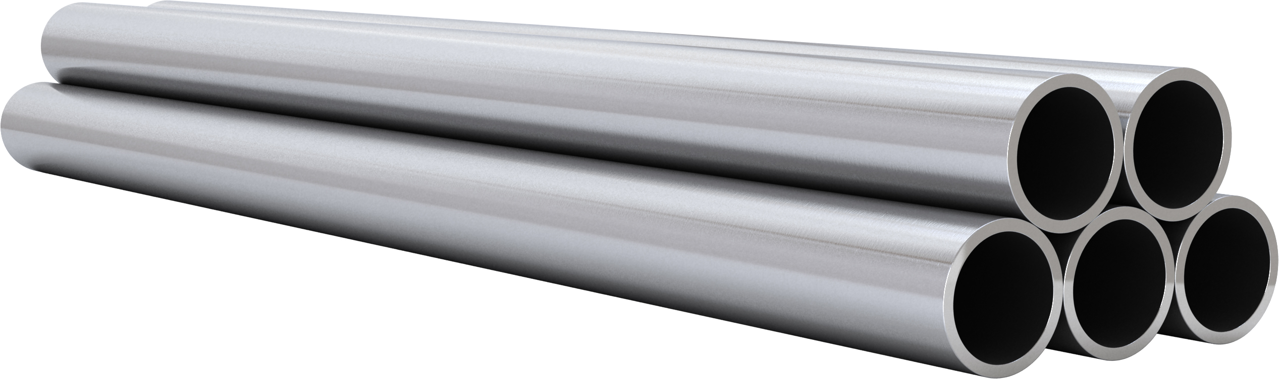
Cladding
The purpose of the cladding is to
Hold the pellets together so that coolant can freely flow past
Transport heat from fuel to the coolant
Contain fission products
Contain fuel fragments
We would also prefer if the cladding had little to no impact on the neutron transport in the reactor

Slide 23
Why Zirconium alloys?
Benefits
Low neutron cross section
Corrosion resistance in 300°C water
Resistance to void swelling
Adequate mechanical properties
Good thermal conductivity
Affordable cost
Available in large quantities
Problems?
Corrosion under high temperature steam
Hydride embrittlement
Anisotropic characteristics lead to creep and growth

Slide 24
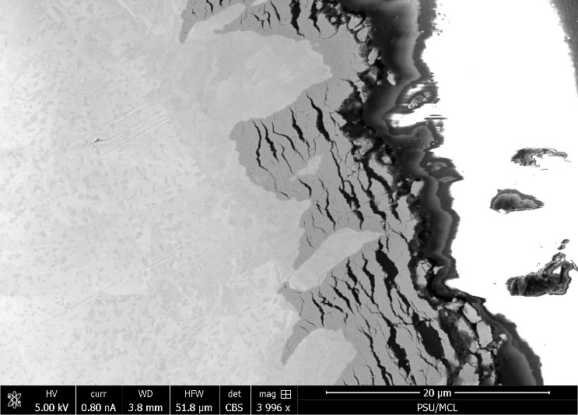
Zirconium
Pure zirconium was not acceptable due to its oxidation behavior
Oxygen with water reacted to form an oxide layer
The oxide layer is brittle and flakes off, allowing more oxidation to occur
Zr alloys were developed to reduce corrosion resistance

Slide 25
Commercial Zr Alloys in PWRs
Alloy | Sn % | Nb % | Fe % | Cr % | Ni % | O % | Fuel Vendor
PWRs (structural components and fuel rods)
Zircaloy-4 (SRA) | 1.2-1.7 | - | 0.18-0.24 | 0.07-0.13 | - | 0.1-0.14
ZIRLO (SRA) | 1 | 1 | 0.1 | - | - | 0.12 | W
Optimized ZIRLO (pRXA) | 0.7 | 1 | 0.1 | - | - | 0.12 | W
M5 (RXA) | - | 0.8-1.2 | 0.015-0.06 | - | - | 0.09-0.12 | AREVA
HPA-45 (SRA/RXA) | 0.6 | - | Fe+V | - | - | 0.12 | AREVA
NDA (SRA) | 1 | 0.1 | 0.3 | 0.2 |  | 0.12 | NFI
MDA (SRA) | 0.8 | 0.5 | 0.2 | 0.1 |  | 0.12 | MHI/MNF

Slide 26
Summary
Zirconium alloys used as cladding
Zirconium fabricated into an alloy to increase corrosion resistance
There are a number of Zr alloys utilized in PWRs as cladding and structural materials

